Slide 1
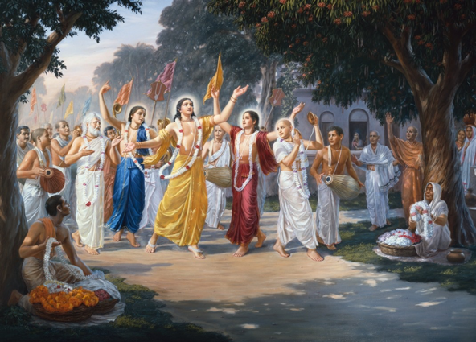
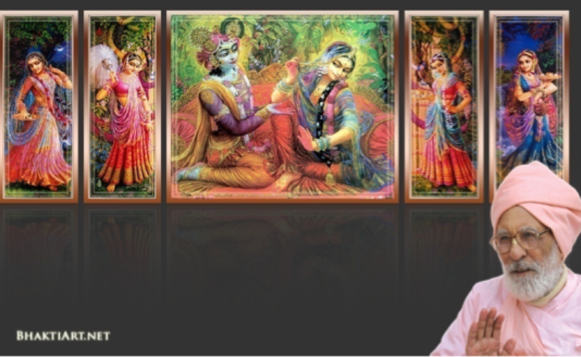
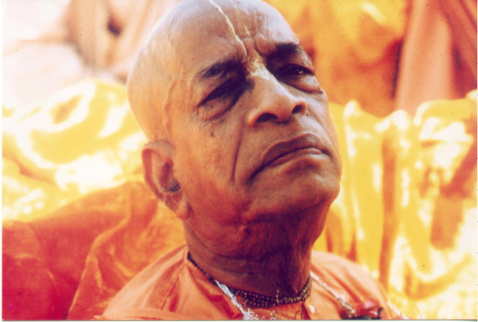
Week: 0451
2018-Mar-09
Gokul Bhajan & Vedic Studies
www.gokulbhajan.com
Notes:
Om Ajnana timirandhasya, jnananjana salakaya
Caksur unmimiltam yena, tasmai sri gurave namah
Namah om vishnu padaya, radhikayah priyatmane
Sri-srimad bhaktivedanta, narayana iti namine
Sri krishna lila kathane sudaksham, Audarya-madhurya gunais ca yuktam
Varam varenyam purusham mahantam, Narayanam tvam sirasa namami
He krishna karuna sindho, dina bandho jagat pate
Gopesha gopika kanta, radha kanta namo ‘stu te
Tapta kancana gaurangi, radhe vrindavaneshvari
vrsabhanu sute devi, pranamami hari priye
Sri Krsna Caitanya…
Hare Krsna …..
—————————————
First of all, I pay my koti dandavat pranams to my diksha guru Om vishnupada rupanuga acharya Sri Sri Bhakti Vedanta Narayana Goswami maharaja. My koti dandavat pranams to Sri Sri Bhakti Vedanta Swami Prabhupada, and guru varga.
My humble pranams at the lotus feet of all assembled devotees, vaishnavas and vaishnavis..

Slide 2
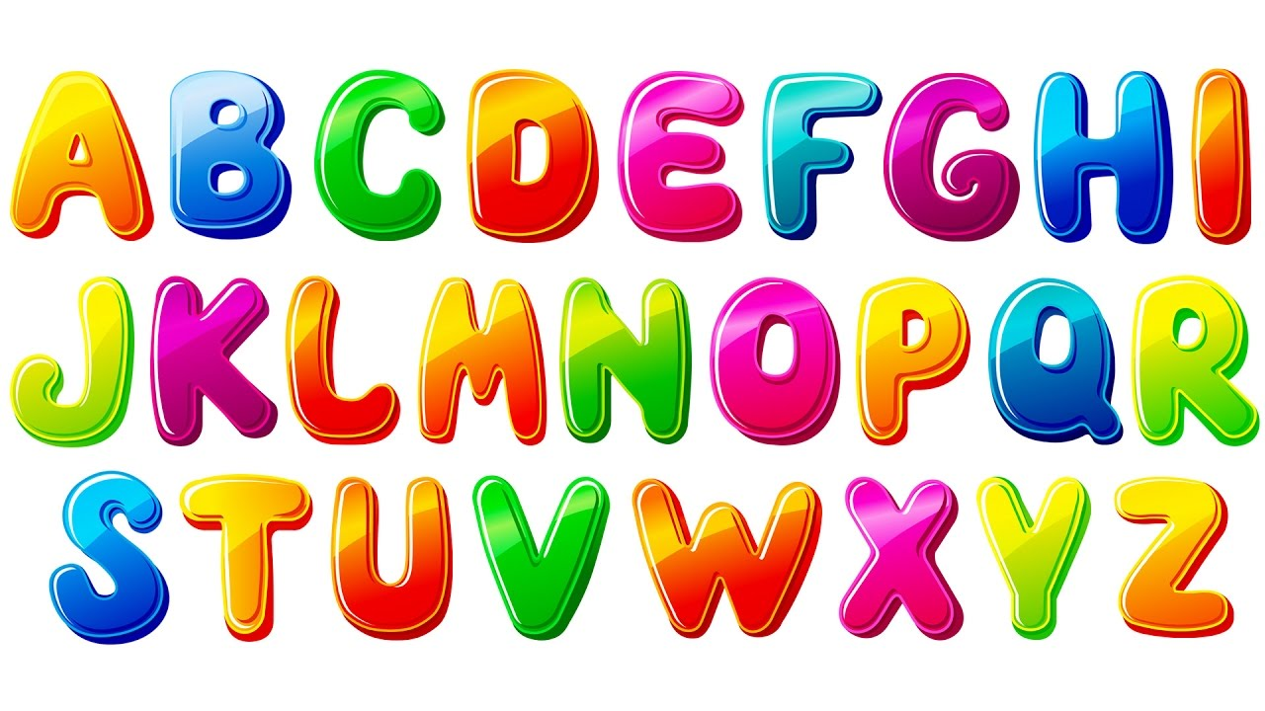
What is Gokul Bhajan ABCD?

Slide 3
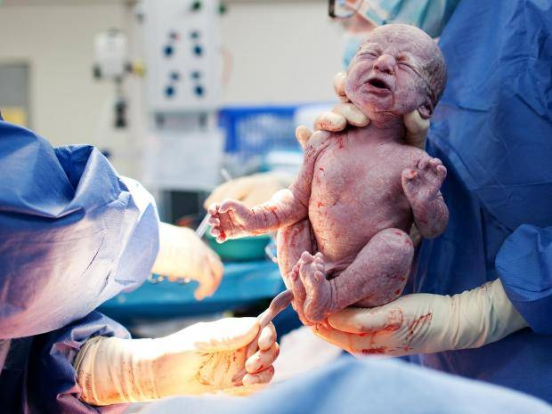
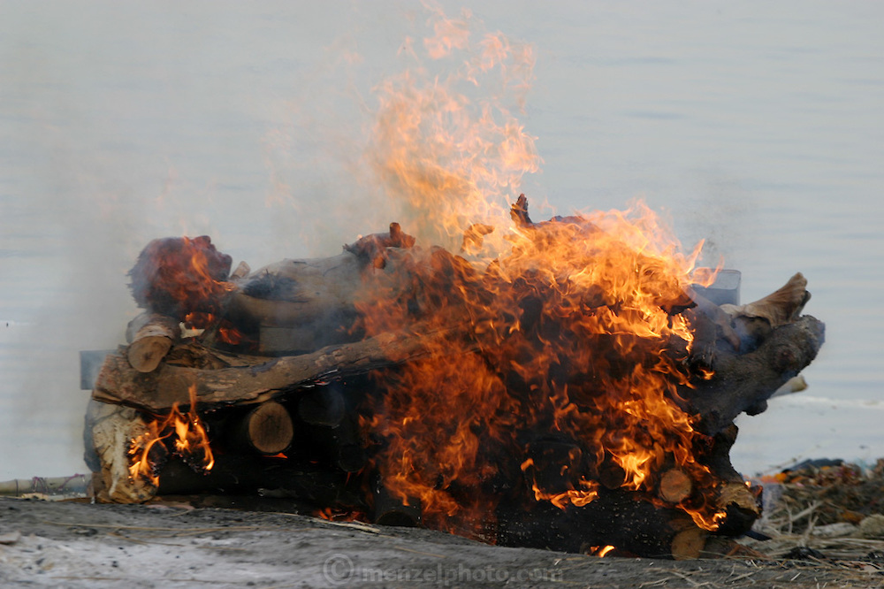
ABCD of Gokul Bhajan!
Along
Birth
Came
Death
Notes:
When a baby is born,
people may not know
that the death also has taken birth!

Slide 4
ABCD of Gokul Bhajan!
Eager
For
God
Notes:
Our only purpose is to develop bhakti
by developing eager to know God.
Who is that God?

Slide 5
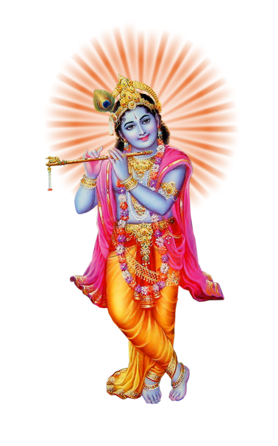
ABCD of Gokul Bhajan!
He
Is
Joyous
Krishna!
Notes:
Who is that God?
He is ever joyful Krishna!

Slide 6
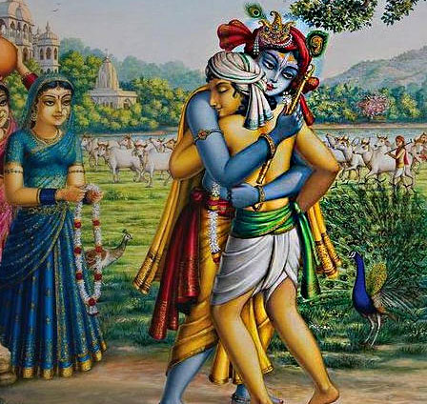
ABCD of Gokul Bhajan!
Love
Me
Notes:
Love Me - He says!

Slide 7
ABCD of Gokul Bhajan!
Never
Offend
Pious
Notes:
Also He says that
we should not offend pious devotees.

Slide 8
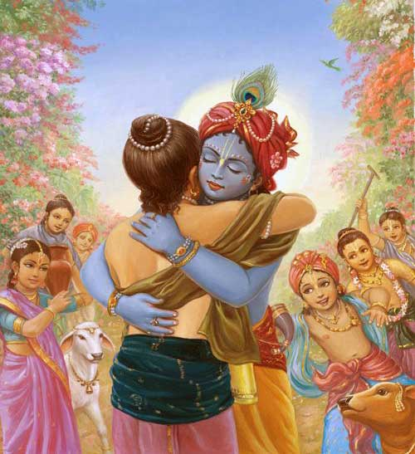
ABCD of Gokul Bhajan!
Quick
Return..
Notes:
For retuning to Krishna quick...

Slide 9
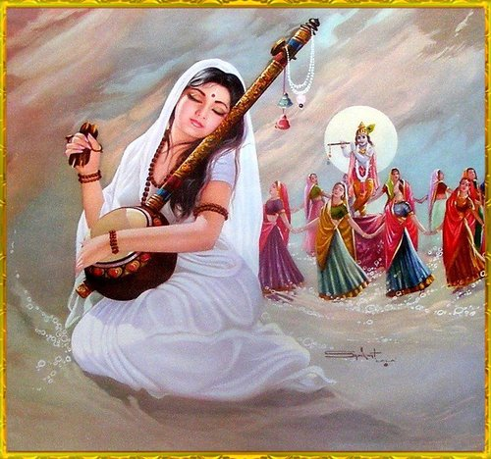
ABCD of Gokul Bhajan!
Sing
Tears
Undivided
Notes:
We should sing in tears with undivided devotion..

Slide 10
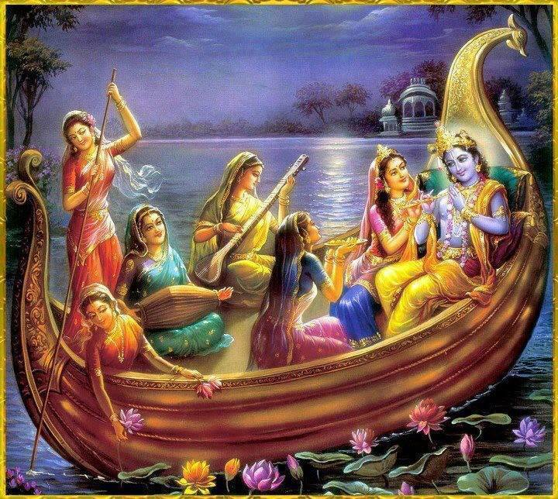
ABCD of Gokul Bhajan!
Vrindavan
World
Notes:
If we do,
Then the Vrindavan World..

Slide 11
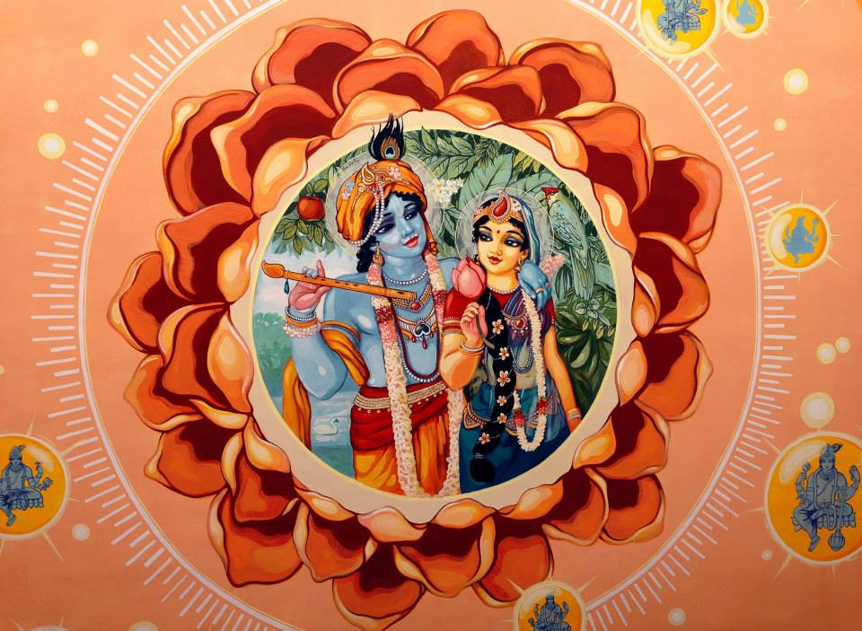
ABCD of Gokul Bhajan!
Xclusively
Your
Zenith
Notes:
will become exclusively your zenith!

Slide 12
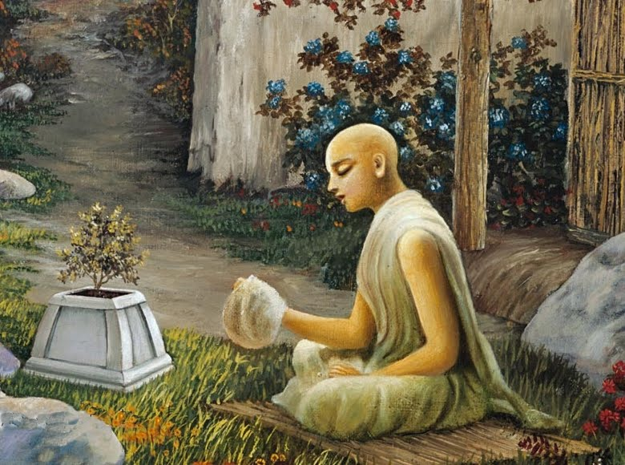
ABCD of Gokul Bhajan!
Another thing about BCD..
Between B and D is C.
C is for the Choice
Let the Choice be Chanting!
Notes:
Between B and D is C.
C is for the Choice as what we want to do.
Let that be Chanting!

Slide 13
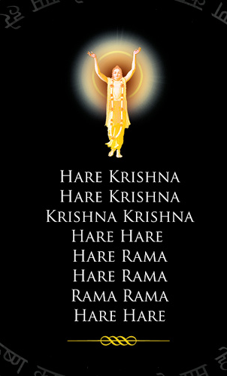
Now I know my ABCD
Chant and be very Happy Thee!

